Slide 1
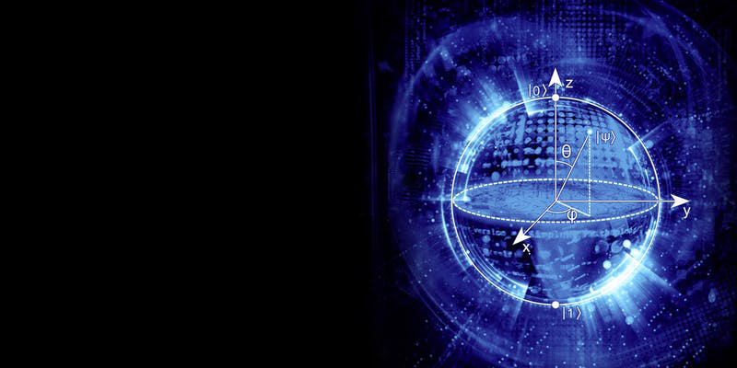
Quantum image processing
Galaxy Classification with FRQI
JediMasters
Tina Sebastian
Eunice Ofori Addo
Eduard Smetanin
Santanu Ganguly

Slide 2

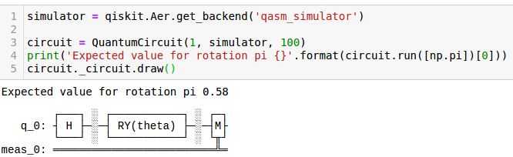
Method to Madness
Get Data : Galaxy Zoo or a subset toy database ( astroCNN Galaxy10)
Define FRQI: Ref https://pdfs.semanticscholar.org/0a3b/dfb66973144792533d763e9edaec40b2785b.pdf
Image is stored in the following state:
Create the circuit
Apply FRQI (frqi_qkt.py) to images
Run Quantum Neural Network with PyTorch and Qiskit (ref.: https://qiskit.org/textbook/ch-machine-learning/machine-learning-qiskit-pytorch.html#prelims

Slide 3
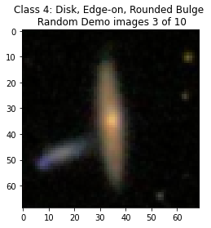
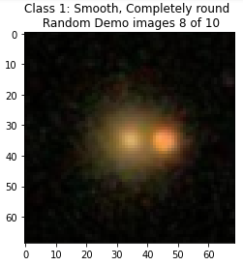
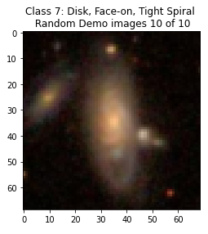
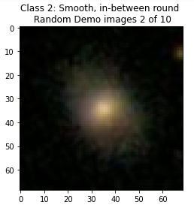
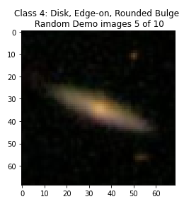
Notes:
Researchers at cities at Night project are using citizen science to get manual matching.
They give people a problem image like and ask them… is this Tokyo, Sapporo, Nagoya maybe…?

Slide 4
1
2
3
4
Image matching with Qiskit:
Classical image preparation
Quantum encoding
Quantum edge detection
Quantum matching

Slide 5
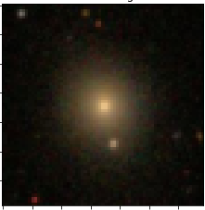
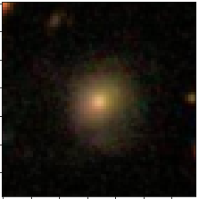
1
2
3
4
1. Image preparation
Disk
What?
FRQI
Why?

Slide 6




1
2
3
4
2. Quantum encoding FRQI
(Flexible Representation of Quantum Images)
$$F_{ij}→\sum_{k=0}^{2^{n}−1}{C_{k}\left[\left.k\right\rangle \right.}$$
What?
Classical bit / pixels qubits
Why?
Advantage. m pixels n = log₂ (m) qubits
But
Data loading: m gates m pixels
$$\sim$$

Slide 7
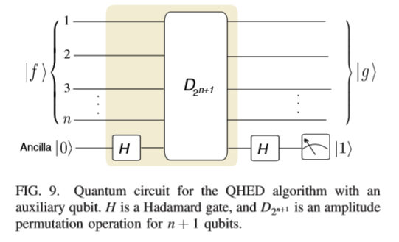
1
2
3
4
3. Quantum edge detection
Source: Yao, X. W., Wang, H., Liao, Z., Chen, M. C., Pan, J., Li, J., ... & Zheng, W. (2017). Quantum image processing
and its application to edge detection: Theory and experiment. Physical Review X, 7(3), 031041.

Slide 8
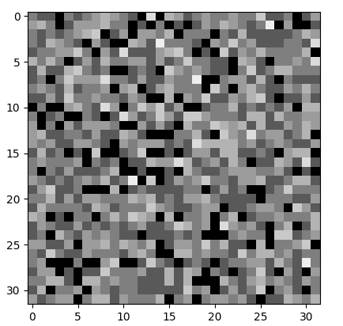
1
2
3
4
3. Quantum edge detection
Classical edge detection
Quantum edge detection

Slide 9
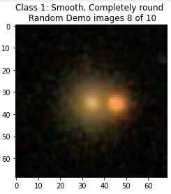
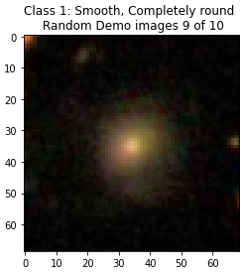
1
2
3
4
4. Quantum matching
Problem picture
Options

Slide 10
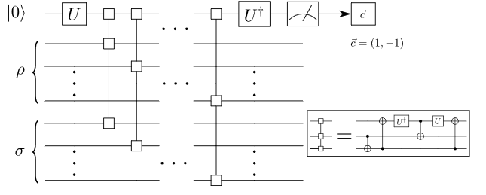

1
2
3
4
4. Quantum matching
Quantum based similarity method: Swap
Source: Cincio, L., Subaşı, Y., Sornborger, A. T., & Coles, P. J. (2018). Learning the quantum algorithm for state
overlap. New Journal of Physics, 20(11), 113022.

Slide 11
References
[1] https://arxiv.org/abs/1910.00774
[2] https://doi.org/10.1093/mnras/stz3006
[3] https://arxiv.org/abs/1801.01465
[4] https://data.galaxyzoo.org/
[5] https://pdfs.semanticscholar.org/0a3b/dfb66973144792533d763e9edaec40b2785b.pdf
[6] https://www.researchgate.net/publication/257641933_NEQR_A_novel_enhanced_quantum_representation_of_digital_images
[7] https://astronn.readthedocs.io/en/latest/
[8] https://qiskit.org/textbook/ch-machine-learning/machine-learning-qiskit-pytorch.html#prelims.
THANKS!!!

